Slide 1
World Youth Unemployment Rate
Created By
Sukil Siva. S

Slide 2
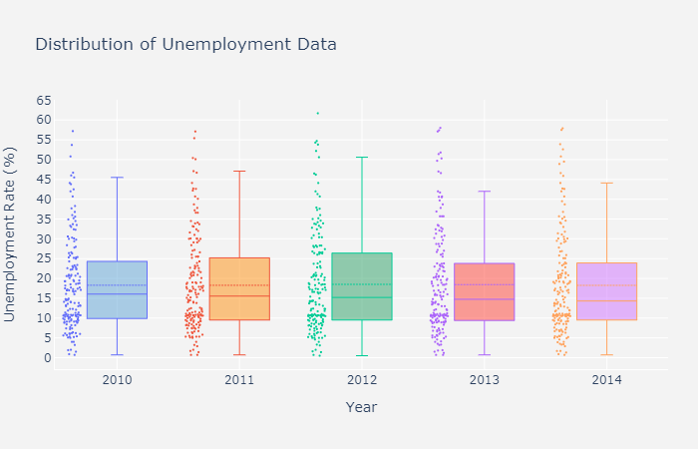
Distribution Chart

Slide 3
Summary of distribution chart
The box plot along with the scatter data helps us to visualize the data in a better way. From the box plots it can be easily seen that the mean of the data over the years remains almost constant with 18.285 % in 2010 to 18.2546 % in 2014. Aside from that it is readily observed that median in each case is lower than the average suggesting that unemployment in majority of the countries is lower than the average unemployment rate. The median range however varies from 16.05 % (2010) to 14.3 % (2014) peaking in 2010 thus suggesting that overall in majority of the countries the unemployment rate has gone down, though only marginally. Most of the data is in the IQR (Inter Quartile Range) throughout the years that data has been collected with only a small number of cases each year that lie beyond the upper bound suggesting presence of severe unemployment in countries represented by these. These are usually the outliers in the data evidenced from their being small in numbers (out of 174 countries only around 5 of these have unemployment rates outside the upper bound in 2010)

Slide 4
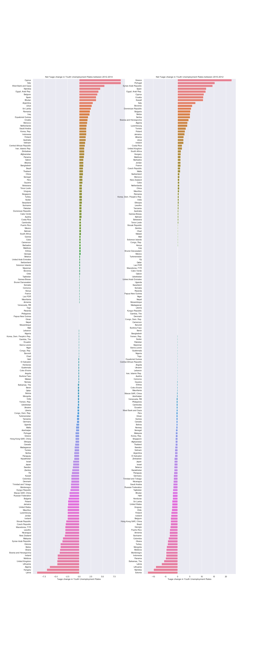
Net % change from 2010-2014

Slide 5
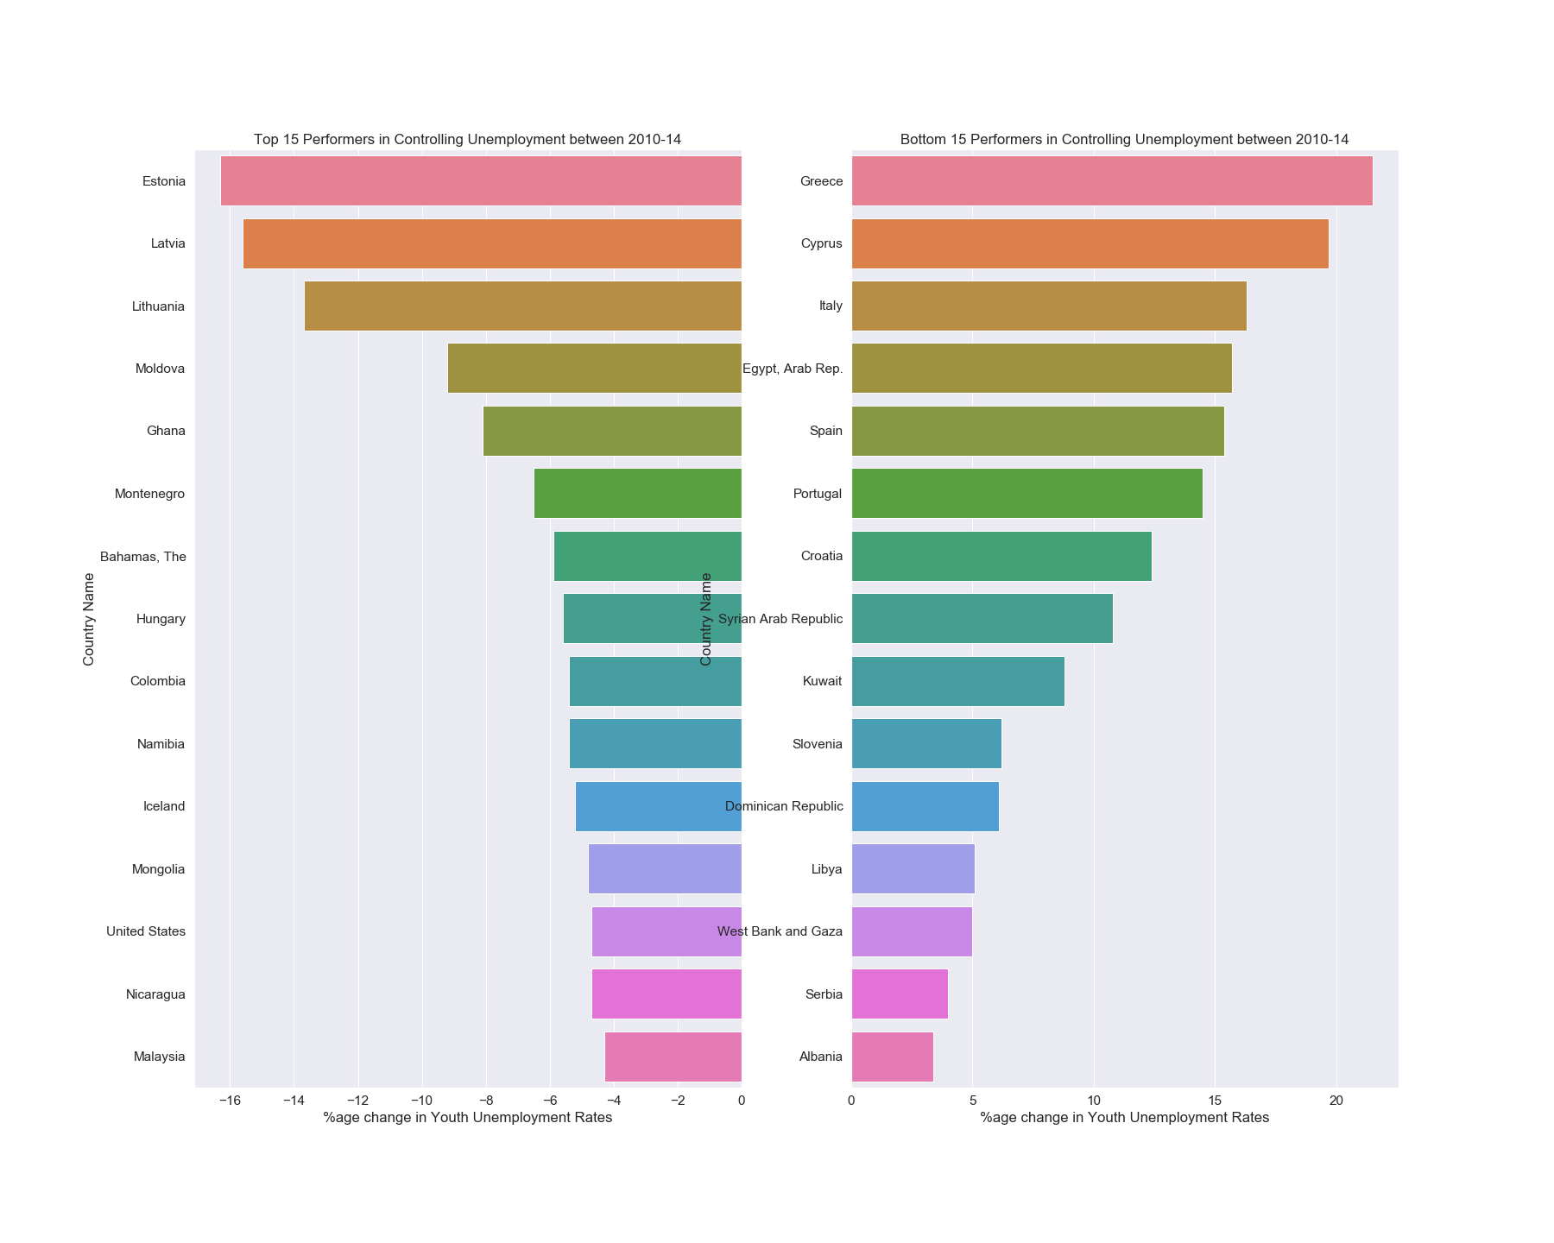
Top and bottom 15 countries in controlling unemployment

Slide 6
Summary of bar charts
Inferences from Graphs :
Although the net change in unemployment rates over 2 year periods (2010-'12 & 2012-'14) has been plotted for all countries, I am mainly going to keep this discussion focused on the long term change (2010-'14) and that to on countries which are either most successful or an utter failure in dealing with rising unemployment rates. These long term rates is basically a mirror to the willingness/unwillingness of the particular country's govt. to achieve sustainable growth in employment opportunities to counter the rising unemployment.
Top Successful Countries :
The horizontal bar plot on the left hand side shows the top 15 countries which were most successful in dealing with unemployment in their countries over the period of 2010-14. As can be seen most of these countries are in europe with estonia being the most successful in dealing with unemployment having a negative growth rate of -16.29 % although it's unemployment rate still stood at 17 % which is still higher than most other countries. the top 5 countries are Estonia, Latvia, Lithuania, Moldova and Ghana. A special mention to the unemployment rate in USA which is able to achieve a reduction of about 5 % in it's unemployment rate from 2010-14.
Least Successful Countries :
Here again the list of least successful countries is dominated by European countries with countries like Greece, Spain and Italy reeling under high rates of unemployment among it's people. Most of these European countries have seen a double digit increase in their unemployment rates with situations reaching critical proportions in countries like Greece with an unemployment rate of ~54 % in 2014 and Spain suffering under a 57 % unemployment rate. All the countries in this list present a state of gloomy future for their youths with the respective authorities unable to rein in the unemployment monster.
Note: A higher value in the top 15 successful and bottom 15 failures in no way suggest that there are aren't other countries where unemployment isn't as dangerous as in these countries. Take for example South Africa which was already having an unemployment rate of 50.8 % in 2010 which jumped to 52.6 % in 2014, making their 5 year change a lowly ~3 %, as compared to 22 % increase for Greece taking it to 53.9 %. What this bar plots indicate are the countries most capable/ill-equipped to deal with unemployment.

Slide 7
World map
Visualization on Maps : A picture is worth a thousand words (not sure it was exactly this) cannot be more apt when you can associate the names of places with their location on a map. A map containing all the data is much more visually appealing then rows and rows of endless data. A small effort is made here to present all the possible data on a world map.

Slide 8
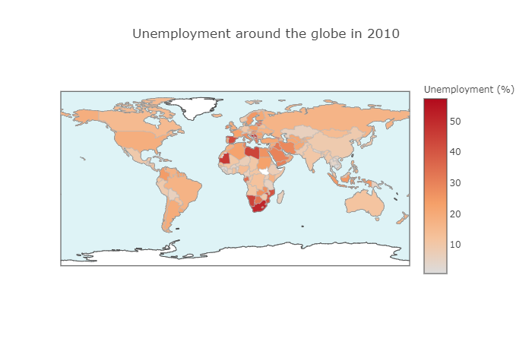
Unemployment rate in 2010

Slide 9
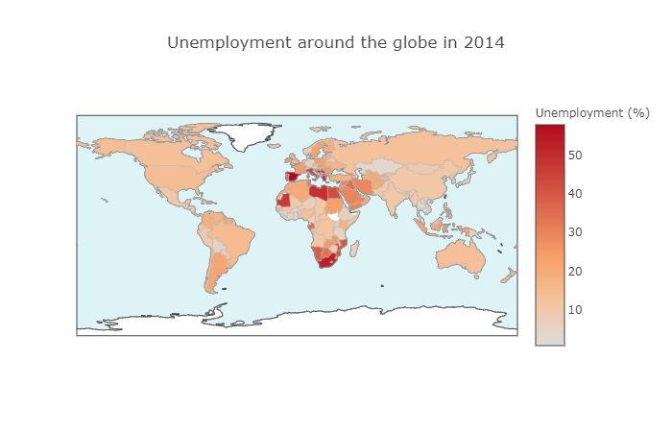
Unemployment rate in 2014

Slide 10
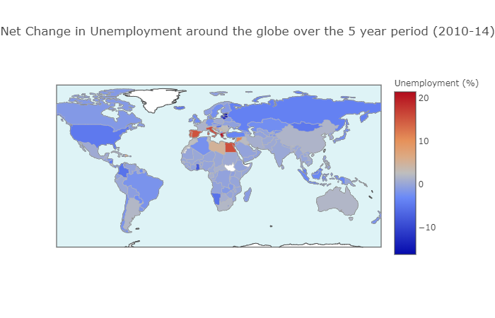
Change in percentage of unemployment rate 2010-2014

Slide 11
Summary of analysis:
From the above data its clearly seen the percentage change in unemployment increase every years
From the above analysis it clear to Understand the peoples in countries Like Africa are already below poverty line and developed people in developed countries to have high chances of unemployment every year
Best and Top 15 countries in controlling the unemployment rates
we have find Distribution of Data

Slide 12
Thank you
For More source code and more plots like scatter plots view the following Link: https://github.com/sukilsiva/Machine-Learnig-Deep-Learning-Code/blob/master/Data%20Visualisations/Notebooks/World_Unemployment_Data_Vizualisation.ipynb

